Slide 1
Facial Recognition Smart Lock using Raspberry Pi
By Naman Tyagi
Enrollment Number : 45115603117

Slide 2
Objective
The objective of this project was to develop a software that would recognize faces of humans using Machine Learning.
Then run this software on a portable computing device such as the raspberry pi.
After which the raspberry pi would be connected to a solenoid lock and make sure everything works properly.
Then tune the software to send some sort of signal to the lock to lock and unlock itself upon the recognition of the user’s face.

Slide 3
Materials Required
Raspberry Pi
Raspberry Pi Camera Module
Relay Module
Solenoid Door Lock
Jumper Cables
External Power Supply ( Output : 12V )/ Power Bank

Slide 4
Ladder of Success
Step 4 : After the recognition of the user, the RPi should send a signal to the solenoid lock to lock and unlock itself.
Step 3 : Create a database of images of the person to be trained so as to detect the user’s face uniquely.
Step 2 : Develop a software to detect all human faces and draw a box around them so as to detect faces.
Step 1 : Install Raspbian OS on the RPi and connect the camera with the CSI Camera Interface to see if everything is working properly.

Slide 5
Step 1
It involves the process of downloading and burning the disc image file of the Raspbian OS onto the SD Card.
After which we download and install all the required dependencies required to start installing OpenCV.
Then we begin downloading and installing OpenCV-3.3.0 from the GitHub Repository.
Lastly, we test the camera module by running code to see if it’s working properly.
The output will look like the image in the next slide.

Slide 6
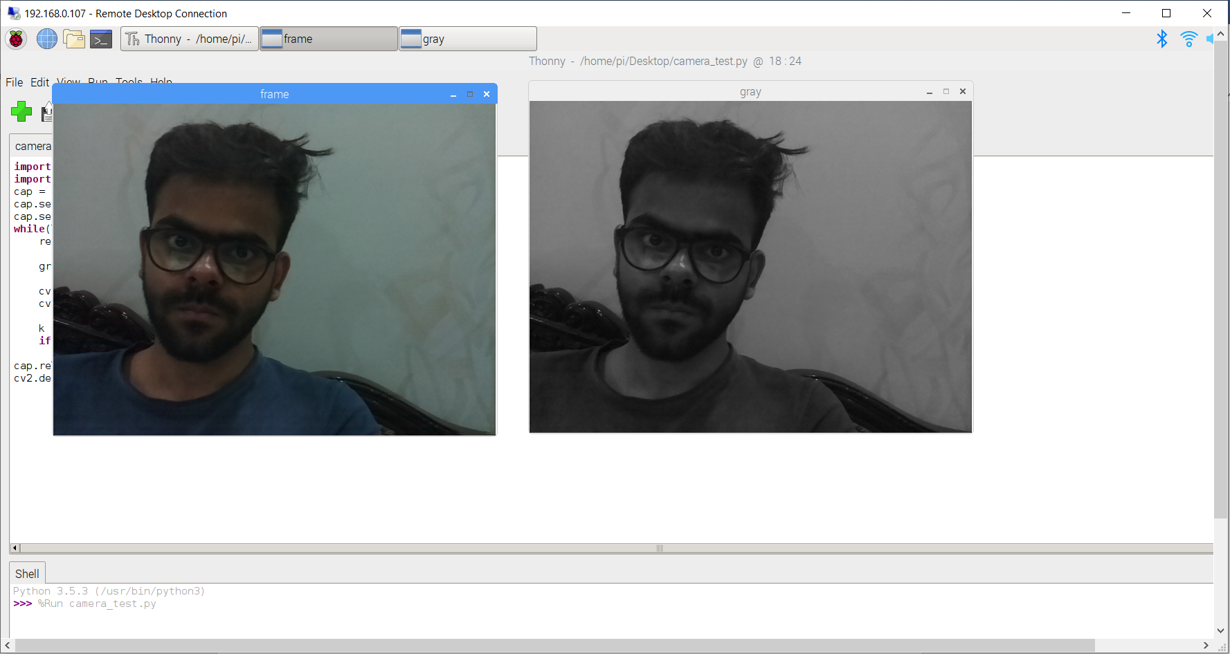

Slide 7
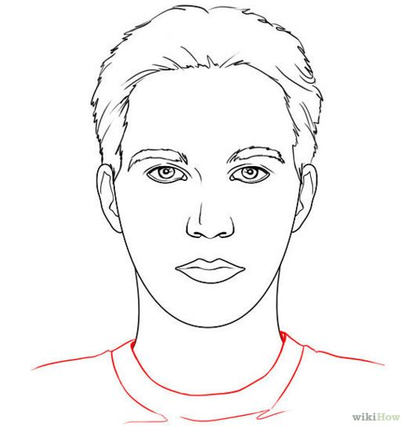
Step 2
In this step we will draw an outline rectangular box around the face using OpenCV.
X,Y
X+W, Y
X, Y+H
X+W, Y+H

Slide 8
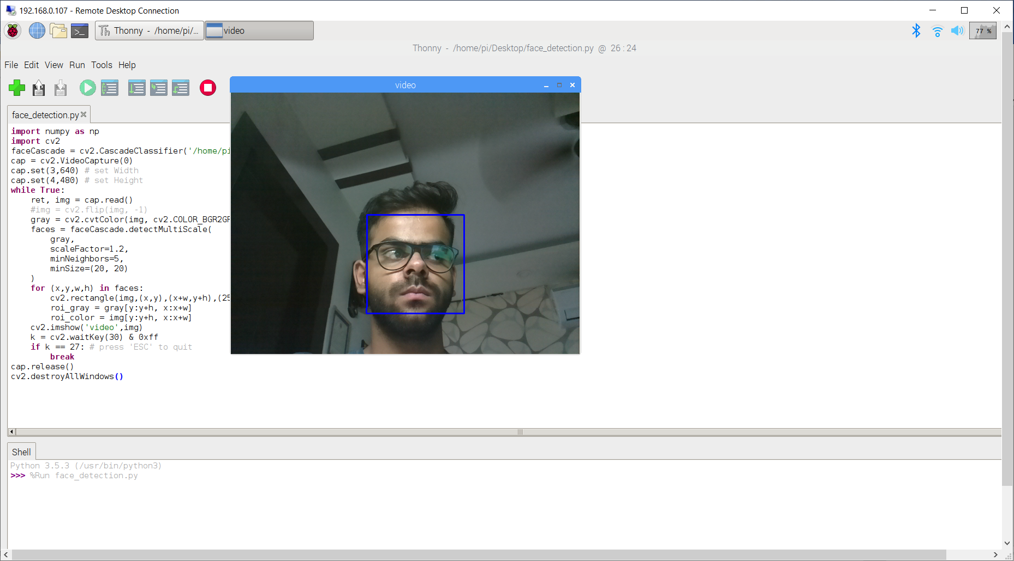

Slide 9
Step 3
This step involves the process of creating a database of the user’s face. It includes pictures of the user’s face from different angles, in different lighting conditions along with images that aren’t faces to train our classifier.
Now that our classifier is trained, it will make predictions of the user’s face whenever it sees another face.
It will put the name and accuracy of the predictions it has made.
Name
Accuracy

Slide 10
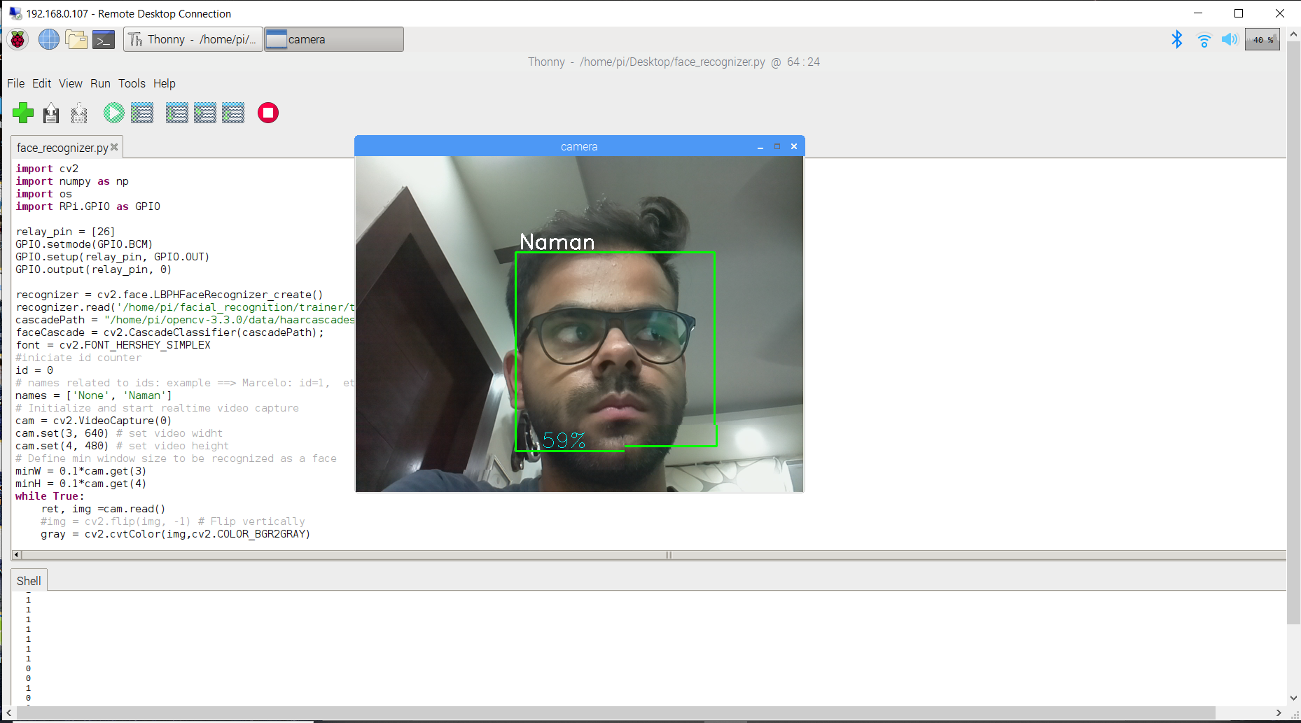

Slide 11
Step 4
This step involves sending a signal to the solenoid lock to unlock itself after the user’s face is detected.
Say, for example, the user is using this for his drawer. The idea is to send a signal when the user’s face is recognized to unlock and then wait 5 seconds and then lock again giving the user enough time to open the drawer. To lock the drawer, the user will show his face for it to be recognized then the system will send a signal for the lock to unlock, wait 5 seconds and in the meantime the user will close the drawer after which the lock will return to lock position again.
The diagram and the real circuit are given in the following slides.

Slide 12
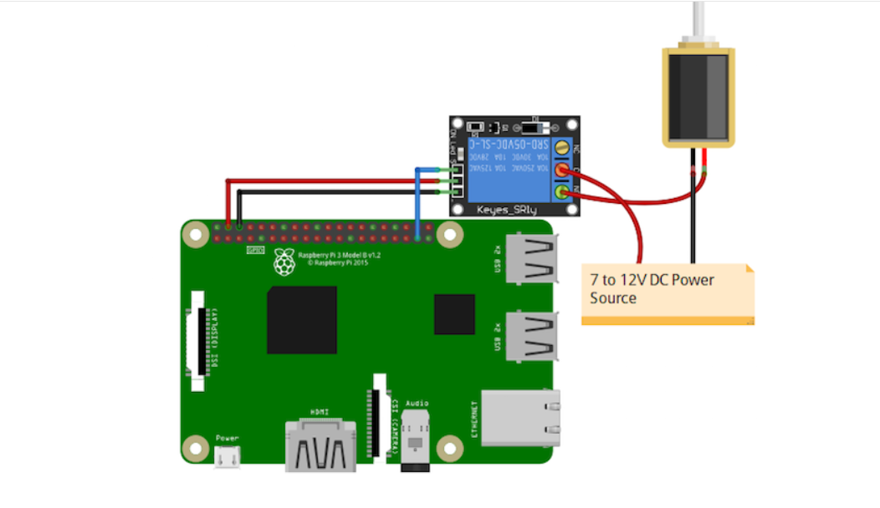
Circuit Diagram
Solenoid Lock
Relay Module
Raspberry Pi
Power Supply/Power Bank

Slide 13
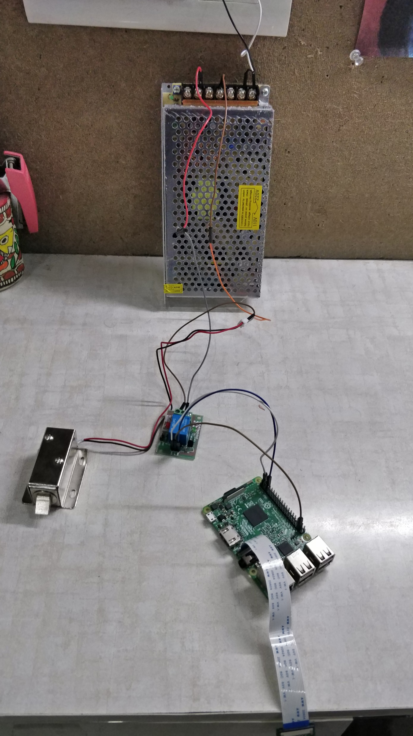
Circuit plugged into AC Supply
Power Supply ( Output = 12V )
RPi
Relay Module
Solenoid Lock

Slide 14
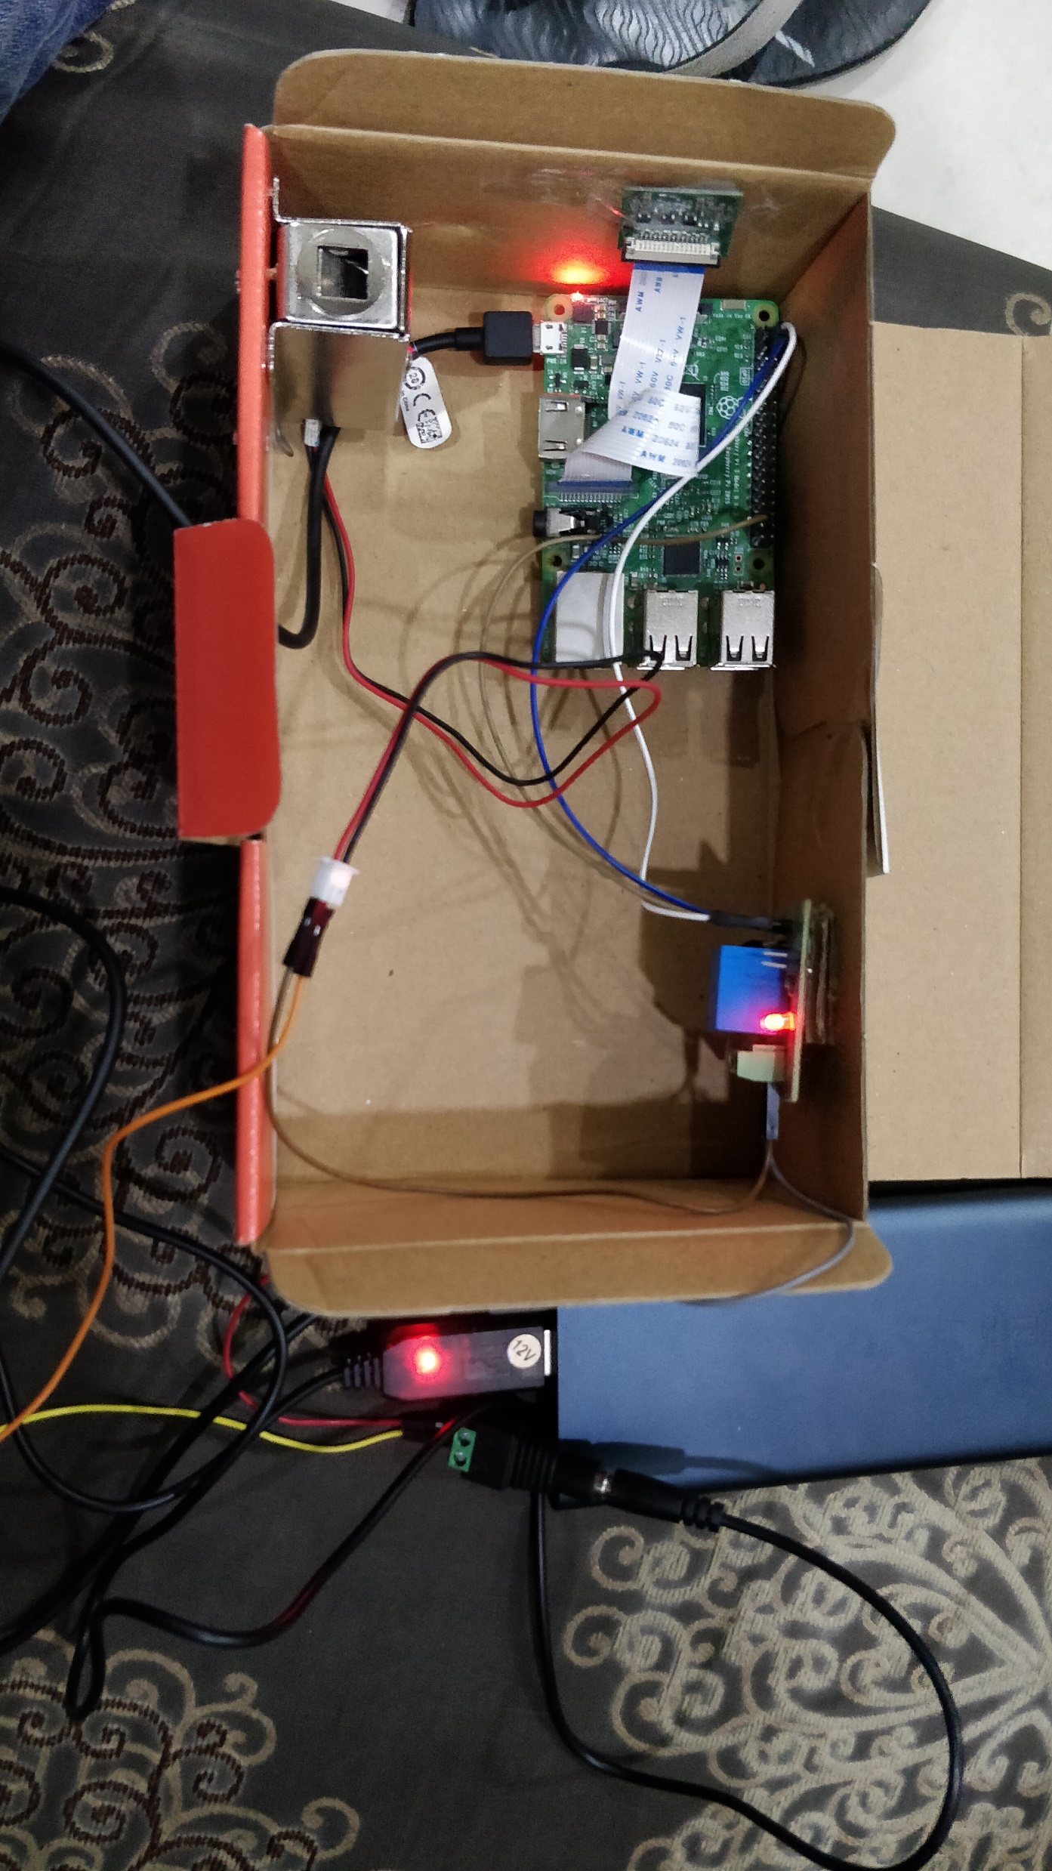
Circuit in portable form
Solenoid Lock
Raspberry Pi
Relay Module
Voltage Amplifier (5V to 12V)
Power Bank
Female Splitter

Slide 15
Thank You

